Slide 1
Alternative Perspectives on Summarization
Systems & Applications
Ling 573
May 28, 2020

Slide 2
Roadmap
Dimensions of summarization: Redux
Alternative views of summarization
Methods:
Abstraction
Domains:
Meetings
Reviews

Slide 3
Abstractive Summarization
Basic components:
Content selection
Information ordering/Content realization

Slide 4
Abstractive Summarization
Basic components:
Content selection
Information ordering/Content realization
Comparable to extractive summarization
Fundamental differences:

Slide 5
Abstractive Summarization
Basic components:
Content selection
Information ordering/Content realization
Comparable to extractive summarization
Fundamental differences:
What do the processes operate on?
Extractive?

Slide 6
Abstractive Summarization
Basic components:
Content selection
Information ordering/Content realization
Comparable to extractive summarization
Fundamental differences:
What do the processes operate on?
Extractive? Sentences (or subspans)
Abstractive?

Slide 7
Abstractive Summarization
Basic components:
Content selection
Information ordering/Content realization
Comparable to extractive summarization
Fundamental differences:
What do the processes operate on?
Extractive? Sentences (or subspans)
Abstractive? Major question
Need some notion of concepts, relations in text

Slide 8
Levels of Representation
How can we represent concepts, relations from text?
Ideally, abstract away from surface sentences

Slide 9
Levels of Representation
How can we represent concepts, relations from text?
Ideally, abstract away from surface sentences
Build on some deep NLP representation:

Slide 10
Levels of Representation
How can we represent concepts, relations from text?
Ideally, abstract away from surface sentences
Build on some deep NLP representation:
Dependency trees: (Cheung & Penn, 2014)
Discourse parse trees: (Gerani et al, 2014)

Slide 11
Levels of Representation
How can we represent concepts, relations from text?
Ideally, abstract away from surface sentences
Build on some deep NLP representation:
Dependency trees: (Cheung & Penn, 2014)
Discourse parse trees: (Gerani et al, 2014)
Logical Forms
Abstract Meaning Representation (AMR): (Liu et al, 2015)

Slide 12
Levels of Representation
How can we represent concepts, relations from text?
Ideally, abstract away from surface sentences
Build on some deep NLP representation:
Dependency trees: (Cheung & Penn, 2014)
Discourse parse trees: (Gerani et al, 2014)
Logical Forms
Abstract Meaning Representation (AMR): (Liu et al, 2015)
Build on a neural representation:
Encoder-Decoder; Graph representations

Slide 13
Representations
Different levels of linguistic representation:
Syntax, Semantics, Discourse

Slide 14
Representations
Different levels of linguistic representation:
Syntax, Semantics, Discourse
All embed:
Some nodes/substructure capturing concepts
Some arcs, etc capturing relations
In some sort of graph representation (maybe a tree)
Different types of representation:
Explicit linguistic vs implicit neural models

Slide 15
Representations
Different levels of linguistic representation:
Syntax, Semantics, Discourse
All embed:
Some nodes/substructure capturing concepts
Some arcs, etc capturing relations
In some sort of graph representation (maybe a tree)
Different types of representation:
Explicit linguistic vs implicit neural models
What’s the right level/type of representation??

Slide 16
One Typical Approach
Parse original documents to deep ling representation

Slide 17
One Typical Approach
Parse original documents to deep ling representation
Manipulate resulting graph for content selection
Splice dependency trees, remove satellite nodes, etc

Slide 18
One Typical Approach
Parse original documents to deep ling representation
Manipulate resulting graph for content selection
Splice dependency trees, remove satellite nodes, etc
Generate based on resulting revised graph

Slide 19
One Typical Approach
Parse original documents to deep ling representation
Manipulate resulting graph for content selection
Splice dependency trees, remove satellite nodes, etc
Generate based on resulting revised graph
Rely on parsing/generation to/from representation

Slide 20
Typical Neural Approach
Create hierarchical neural representation
Initial word embeddings
Recurrent sentence embeddings over words
Document representations over sentences
Attention models
Graph (+/- att’n) models
Generate from neural representation

Slide 21
AMR
“Abstract Meaning Representation”
Sentence-level semantic representation

Slide 22
AMR
“Abstract Meaning Representation”
Sentence-level semantic representation
Nodes: Concepts:
English words, PropBank predicates, or keywords (‘person’)

Slide 23
AMR
“Abstract Meaning Representation”
Sentence-level semantic representation
Nodes: Concepts:
English words, PropBank predicates, or keywords (‘person’)
Edges: Relations:
PropBank thematic roles (ARG0-ARG5)
Others including ‘location’, ‘name’, ‘time’, etc…
~100 in total

Slide 24
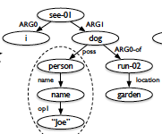
AMR 2
AMR Bank: ~40K annotated sentences
JAMR parser:
Alignments b/t word spans & graph fragments
Example: “I saw Joe’s dog, which was running in the garden.”
Liu et al, 2015.

Slide 25
Summarization Using Abstract Meaning Representation
Use JAMR to parse input sentences to AMR

Slide 26
Summarization Using Abstract Meaning Representation
Use JAMR to parse input sentences to AMR
Create unified document graph
Link coreferent nodes by “concept merging”
Join sentence AMRs to common (dummy) ROOT
Create other connections as needed

Slide 27
Summarization Using Abstract Meaning Representation
Use JAMR to parse input sentences to AMR
Create unified document graph
Link coreferent nodes by “concept merging”
Join sentence AMRs to common (dummy) ROOT
Create other connections as needed
Select subset of nodes for inclusion in summary
Modeled as ILP for subgraph selection
*Generate surface realization of AMR (future work)
Liu et al, 2015.

Slide 28
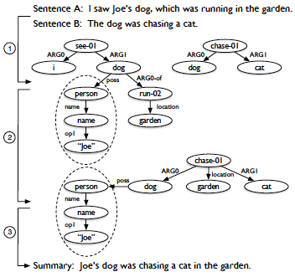
Toy Example
Liu et al, 2015.

Slide 29
Neural Framework
Core structure:
Encoder-Decoder model
Encoder: Creates representation of content to summarize
Builds on word or character embeddings
Either pretrained or learned
Typically, RNN models: LSTM or GRU
Decoder: Generates output sequence
Uses representation from encoder + previously generated wds
Also often RNN

Slide 30
Improvements
Additions to base encoder-decoder models
Attention:
Adds weight distribution over inputs
Beyond single encoding vector
Pointer/copy mechanisms:
Mitigates issues with rare terms
Decoder incorporates a switch to either generate
Or copy a region over from the input

Slide 31
Observations
Similar focus on identifying key content
Challenges in:
Handling longer texts
Creating multi-sentence/multi-document representations
Generating extended texts
Hard for both linguistically motivated and neural models
Generating rare terms
Balancing copying (repetitive) with
Novel generation (hard)

Slide 32
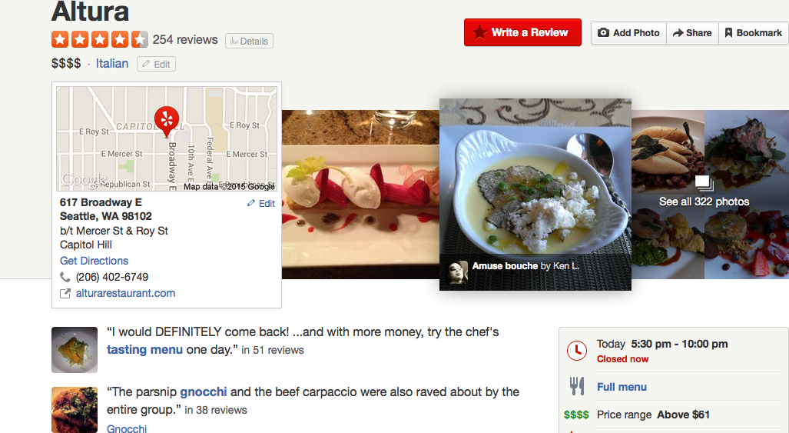
Review Summaries

Slide 33
Review Summary Dimensions
Use purpose:
Audience:
Derivation (extactive vs abstractive):
Coverage (generic vs focused):
Units (single vs multi):
Reduction:
Input/Output form factors (language, genre, register, form)

Slide 34
Review Summary Dimensions
Use purpose: Product selection, comparison
Audience: Ordinary people/customers
Derivation (extactive vs abstractive): Extractive+
Coverage (generic vs focused): Aspect-oriented
Units (single vs multi): Multi-document
Reduction: Varies
Input/Output form factors (language, genre, register, form)
??, user reviews, less formal, pros & cons, tables, etc

Slide 35
Sentiment Summarization
Classic approach: (Hu and Liu, 2004)
Summarization of product reviews (e.g. Amazon)
Identify product features mentioned in reviews
Identify polarity of sentences about those features
For each product,
For each feature,
For each polarity: provide illustrative examples

Slide 36
Example Summary
Feature: picture
Positive: 12
Overall this is a good camera with a really good picture clarity.
The pictures are absolutely amazing - the camera captures the minutest of details.
After nearly 800 pictures I have found that this camera takes incredible pictures.
…
Negative: 2
The pictures come out hazy if your hands shake even for a moment during the entire process of taking a picture.
Focusing on a display rack about 20 feet away in a brightly lit room during day time, pictures produced by this camera were blurry and in a shade of orange.

Slide 37
Learning Sentiment Summarization
Classic approach is heuristic:
May not scale, etc.

Slide 38
Learning Sentiment Summarization
Classic approach is heuristic:
May not scale, etc.
What do users want?

Slide 39
Learning Sentiment Summarization
Classic approach is heuristic:
May not scale, etc.
What do users want?
Which example sentences should be selected?
Strongest sentiment?
Most diverse sentiments?
Broadest feature coverage?

Slide 40
Review Summarization Factors
Posed as optimizing score for given length summary
Using a sentence extractive strategy

Slide 41
Review Summarization Factors
Posed as optimizing score for given length summary
Using a sentence extractive strategy
Key factors:
Sentence sentiment score
Sentiment mismatch: b/t summary and product rating
Diversity:
Measure of how well diff’t “aspects” of product covered
Related to both quality of coverage, importance of aspect

Slide 42
Review Summarization Models I
Sentiment Match (SM): Neg(Mismatch)
Prefer summaries w/sentiment matching product
Issue?

Slide 43
Review Summarization Models I
Sentiment Match (SM): Neg(Mismatch)
Prefer summaries w/sentiment matching product
Issue?
Neutral rating ➔ neutral summary sentences
Approach: Force system to select stronger sents first

Slide 44
Review Summarization Models II
Sentiment Match + Aspect Coverage (SMAC):
Linear combination of:
Sentiment intensity, mismatch, & diversity
Issue?

Slide 45
Review Summarization Models II
Sentiment Match + Aspect Coverage (SMAC):
Linear combination of:
Sentiment intensity, mismatch, & diversity
Issue?
Optimizes overall sentiment match, but not per-aspect

Slide 46
Review Summarization Models III
Sentiment-Aspect Match (SAM):
Maximize coverage of aspects
*consistent* with per-aspect sentiment
Computed using probabilistic model
Minimize KL-divergence b/t summary, orig documents

Slide 47
Human Evaluation
Pairwise preference tests for different summaries
Side-by-side, along with overall product rating
Judged: No pref, Strongly – Weakly prefer A/B
Also collected comments that justify rating

Slide 48
Human Evaluation
Pairwise preference tests for different summaries
Side-by-side, along with overall product rating
Judged: No pref, Strongly – Weakly prefer A/B
Also collected comments that justify rating
Usually some preference, but not significant
Except between SAM (highest) and SMAC (lowest)
Do users care at all?

Slide 49
Human Evaluation
Pairwise preference tests for different summaries
Side-by-side, along with overall product rating
Judged: No pref, Strongly – Weakly prefer A/B
Also collected comments that justify rating
Usually some preference, but not significant
Except between SAM (highest) and SMAC (lowest)
Do users care at all?
Yes!! SMAC significantly better than LEAD baseline
(70% vs 25%)

Slide 50
Qualitative Comments
Preferred:

Slide 51
Qualitative Comments
Preferred:
Summaries with list (pro vs con)
Disliked:

Slide 52
Qualitative Comments
Preferred:
Summaries with list (pro vs con)
Disliked:
Summary sentences w/o sentiment
Non-specific sentences
Inconsistency b/t overall rating and summary

Slide 53
Qualitative Comments
Preferred:
Summaries with list (pro vs con)
Disliked:
Summary sentences w/o sentiment
Non-specific sentences
Inconsistency b/t overall rating and summary
Preferences differed depending on overall rating
Prefer SMAC for neutral vs SAM for extremes
(SAM excludes low polarity sentences)

Slide 54
Conclusions
Ultimately, trained meta-classifier to pick model
Improved prediction of user preferences

Slide 55
Conclusions
Ultimately, trained meta-classifier to pick model
Improved prediction of user preferences
Similarities and contrasts w/TAC:
Similarities:

Slide 56
Conclusions
Ultimately, trained meta-classifier to pick model
Improved prediction of user preferences
Similarities and contrasts w/TAC:
Similarities:
Diversity ~ Non-redundancy
Product aspects ~ Topic aspects: coverage, importance
Differences:

Slide 57
Conclusions
Ultimately, trained meta-classifier to pick model
Improved prediction of user preferences
Similarities and contrasts w/TAC:
Similarities:
Diversity ~ Non-redundancy
Product aspects ~ Topic aspects: coverage, importance
Differences:
Strongly task/user oriented
Sentiment focused (overall, per-sentence)
Presentation preference: lists vs narratives

Slide 58
Wrap-Up
Summarization:
Survey of methods, domains
Extraction, Abstractive
Meetings, reviews, speech, news
Deep dive into TAC guided multi-document task
Content selection, Information ordering, Content realization
Variety of methods
Evaluation

Slide 59
Reminders
Final code deliverable due Sunday
Doodle for presentation times
Manual evaluation instructions/data out Monday

